Slide 1


Department of Electronics and Engineering
AN IOT BASED REAL TIME COMMUNICATION AND LOCATION TRACKING SYSTEM FOR VEHICLE EMERGENCY
Bonam Venkata Chalamayya Engineering College Odalarevu (AUTONOMOUS)
Project Guide:
Ms.K HARIKA SAI DURGA,
Assistant Professor
Project Associatives:
B. SRIVALLIKA (18225A0402)
N.V.V.LAVANAYA (17221A0484)
Y.PAVAN MANIKANTA (17221A04C3)
S.JAGADEESH KUMAR (17221A04A4)

Slide 2
Contents
Abstract
Introduction
What is IOT?
Existing & Proposed method
Block diagram
Hardware implementation
Aurdino
NodeMCU
Software used
Advantages & Applications
Conclusion
Future scope
References

Slide 3
Abstract
In this project, we have presented an IoT enabled approach that can provide emergency communication and location tracking services in a remote car that meets an unfortunate accident or any other emergency situation. Immediately after an accident or emergency, the system either starts or may be triggered manually. Depending upon type of emergency it initiates communication and shares critical information e.g., location information, a set of relevant images taken from prefixed angles etc. With appropriate server/authority.

Slide 4
Introduction
In a smart city every device or better to say every ‘thing’ is connected 24 × 7 to the Ubiquitous network. Right now, we are living in the era of Internet and rapidly moving towards a smart planet where every device will be connected to each other. Internet of Things is the technology helping us to achieve the goal of a smart world. and Cyber Physical system have the ability to change the vision of our way of living. All developing countries are aiming to transform their cities into Smart City by taking several projects. For example, the government of India has taken an initiative called Digital India to connect the nation to Internet. A. Necessity of Vehicular Emergency Communication System in Smart City Perspective

Slide 5
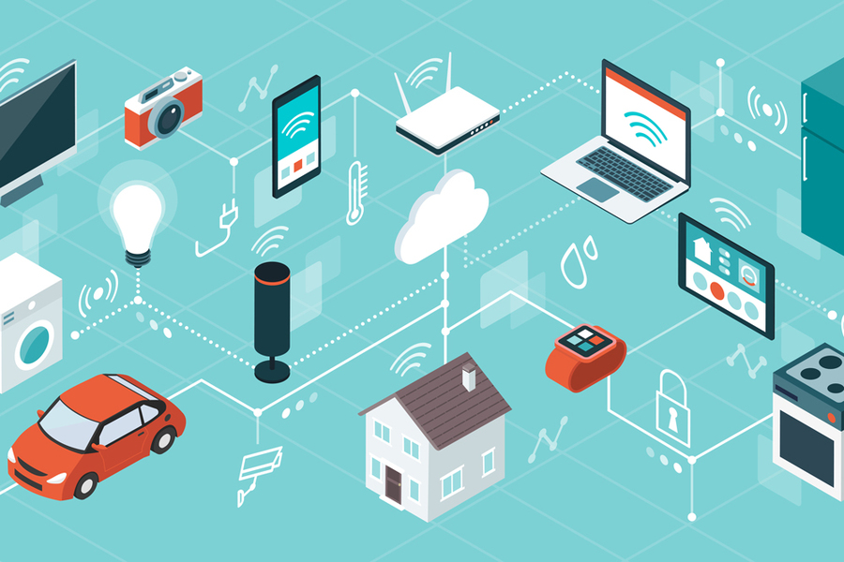
What is IOT?
IOT is short for Internet of things
The internet of things(IOT) is inter – networking
of physical devices. This systems has ability to
transfer data over a network without requiring
human- to- human or human to computer
interaction.

Slide 6
Existing & Proposed method
Existing method:
In Existing method it will not provide GPS location and sending images to control room. It only sends SMS to family member or guardians mobile number.
Proposed method:
In proposed system depending upon type of emergency it initiates communication and shares critical information e.g., location information, a set of relevant images taken from prefixed angles etc. With appropriate server/authority. We have divided vehicular emergencies into five different types accordingly to their characteristics. The details of each parts discussed in following sections.

Slide 7
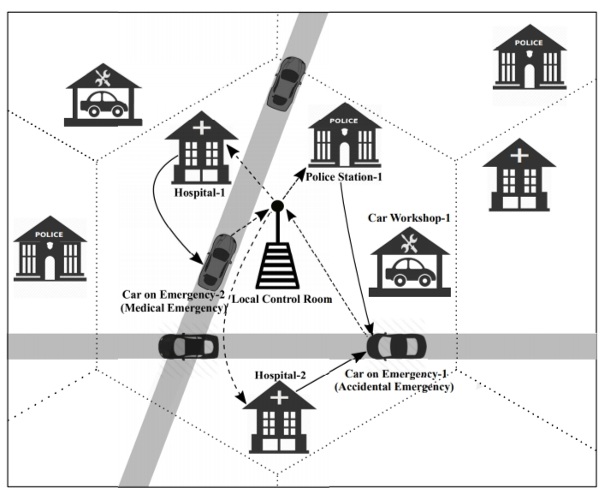
Architectural diagram of the proposed system

Slide 8
Explanation
Type-1(Accident): This is the most important emergency type for a vehicle on road.
Type-2 (Medical): Sometime it happens that a passenger or the driver of a car suddenly becomes sick
Type-3 (Criminal): If a car meets some criminal issue, they can also contact the control room.
Type-4 (Civil): If there is any natural calamity, and the road is blocked by some barrier.
Type-5 (Mechanical): If a vehicle meets some mechanical problems, nearest car workshop is informed.

Slide 9
Block Diagram
L298N Motor Driver
Motors
GPS Module
Aurdino
Blynk sensor
Blynk mobile application
cloud

Slide 10
Hardware Implementation
Aurdino
GPS Module
L298N Motor Driver
Motors
Blynk Sensor

Slide 11
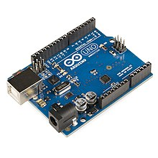
Aurdino
Arduino is an open-source platform used for building electronics projects.
Arduino consists of both a physical programmable circuit board and a piece of software, or IDE that runs on your computer, used to write and upload computer code to the physical board

Slide 12
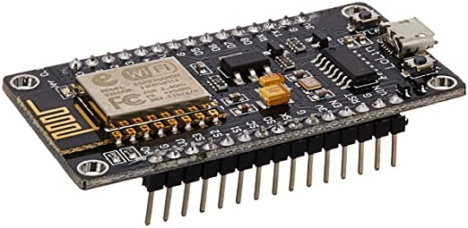
NodeMCU
NodeMCU is an open source firmware for which open source prototyping board designs are available.
It is an open source software and hardware development environment that is built around a very inexpensive System-on-a-Chip called the ESP8266

Slide 13
Software used
This project is implemented using following software’s:
Express PCB – for designing circuit
Arduino IDE compiler - for compilation part
Proteus 7 (Embedded C) – for simulation part

Slide 14
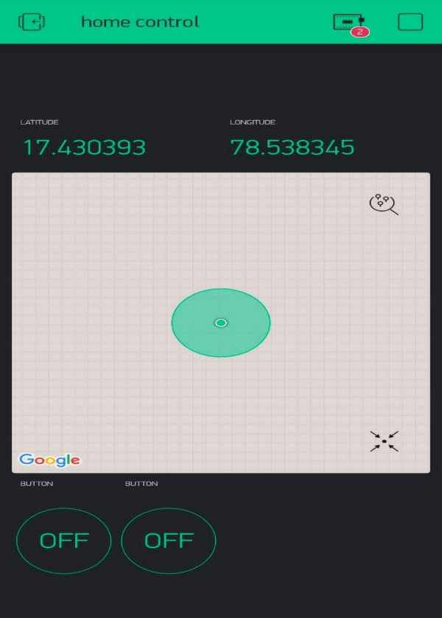
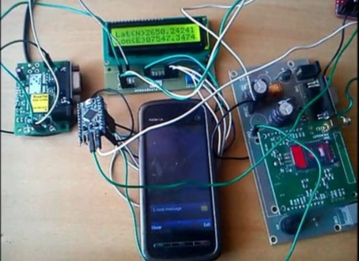
Results

Slide 15
Advantages & Applications
Advantages:
Totally advanced version for vehicle tracking & vehicle emergency.
Easy to use for rural areas.
This application is easy to install.
Applications:
Where security is important there we can implement this project.
Used in cars, buses and trains for emergency.
Position tracking.
The device ensures vehicle security and smooth fleet management.

Slide 16
Conclusion
In this project, we have proposed an emergency contact and location tracking system for vehicular emergencies on road. The system is fully automatic in nature that can help us to minimize accidental and other emergency damages. This prototype is mainly designed for smart cities and IoT enabled vehicles.

Slide 17
Futurescope
This system is only able to send emergency information from a vehicle to nearby rescue centers, but it can’t help to avoid any emergency issues. Also, the system is dependent on several mechanical and electrical devices in a car to detect accident or other emergencies. In future, we would like to include these concerns. Also, we are aiming to design a hardware secured on chip system featuring these services in future.

Slide 18
References
[1] L. Atzori, A. Iera, and G. Morabito, “The Internet of Things: A Survey,” Computer Networks, vol. 54, no. 15, pp. 2787–2805, 2010.
[2] E. A. Lee, “Cyber Physical Systems: Design Challenges,” in Object Oriented Real-Time Distributed Computing (ISORC), 2008 11th IEEE International Symposium on. IEEE, 2008, pp. 363–369.
[3] A. Zanella, N. Bui, A. Castellani, L. Vangelista, and M. Zorzi, “Internet of Ihings for Smart Cities,” Internet of Things Journal, IEEE, vol. 1, no. 1, pp. 22–32, 2014.
[4] “Digital India,” Online, 2015, (Last accessed March 18, 2016). [Online]. Available: http://www.digitalindia.gov.in/
[5] J. Gubbi, R. Buyya, S. Marusic, and M. Palaniswami, “Internet of Things (IoT): A Vision, Architectural Elements, and Future Directions,” Future Generation Computer Systems, vol. 29, no. 7, pp. 1645–1660, 2013.

Slide 19


